Slide 1
Microservices and DevOps
Scalable Microservices
Exam and the Project Course
Henrik Bærbak Christensen

Slide 2
Exam
From the fagbilag:
Procedure
  You have solved three mandatory exercises (= milestones)
  I and censor will read report, determine approximate grade
  Before exam I will publish a defense demo assignment
    Bjarne: Describe and demo the Circuitbreaker on PlayerService
    Birte: Describe and demo your sharding system for CaveService
    Børge: Describe and demo your REST API for MessageService
  Exam: 20 min (Zoom/shared screen) Demo + Slideware
  You will be given a final grade based upon report+defense

Slide 3
Exam
Questions ?

Slide 4
Internal Evaluation
To Appear Later

Slide 5
Evaluation
Just as for the first course, your feedback is important
  I learn a lot from your comments…
So I will some time near/after the exam post a similar anonymous evaluation ☺

Slide 6
The Project Course

Slide 7
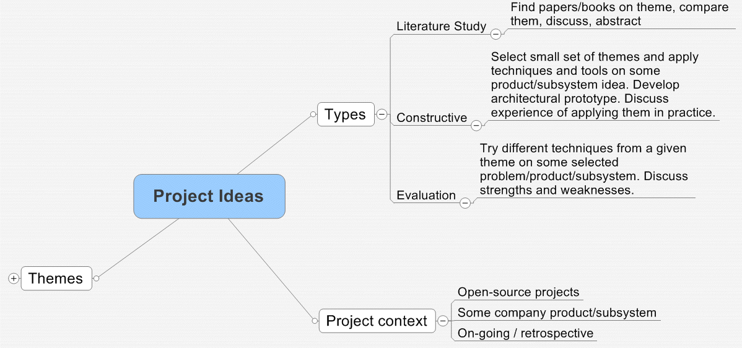
Next Year…
Project course
  Three seminars with no additional curriculum
    Peer review sessions
    Invited talk (Hope is Stibo and Uber)
  Group work on a project
    Typical a constructive project
Earlier reports
  https://baerbak.cs.au.dk/c/ProjectReports/
  I get dig out non-confidential reports for you

Slide 8
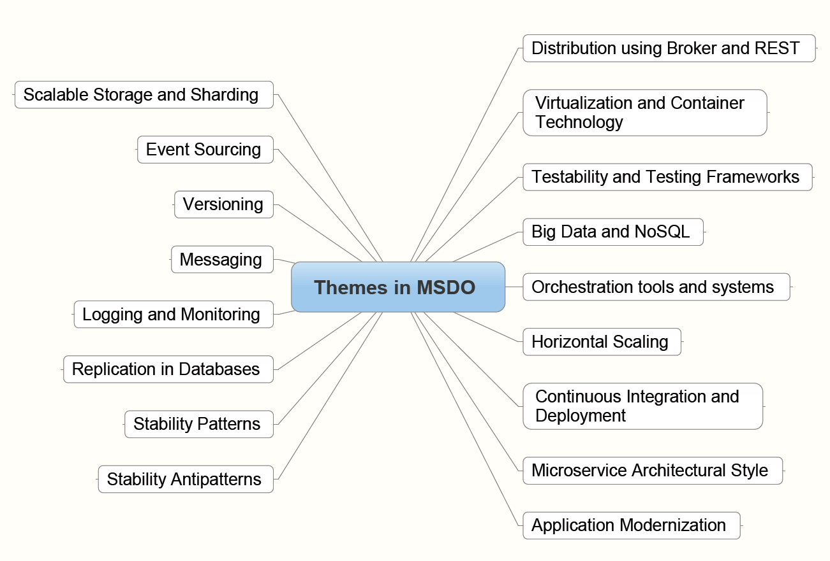
Think about a Project
To have a head start
  Pick a theme from the course
But…
  Any topic within the
  overall topic of
  Microservice/DevOps
  is possible
  I will ‘go/no-go’ all
  proposals

Slide 9
Keep up the good work…

